Slide 1
HAND TOOLS

Slide 2
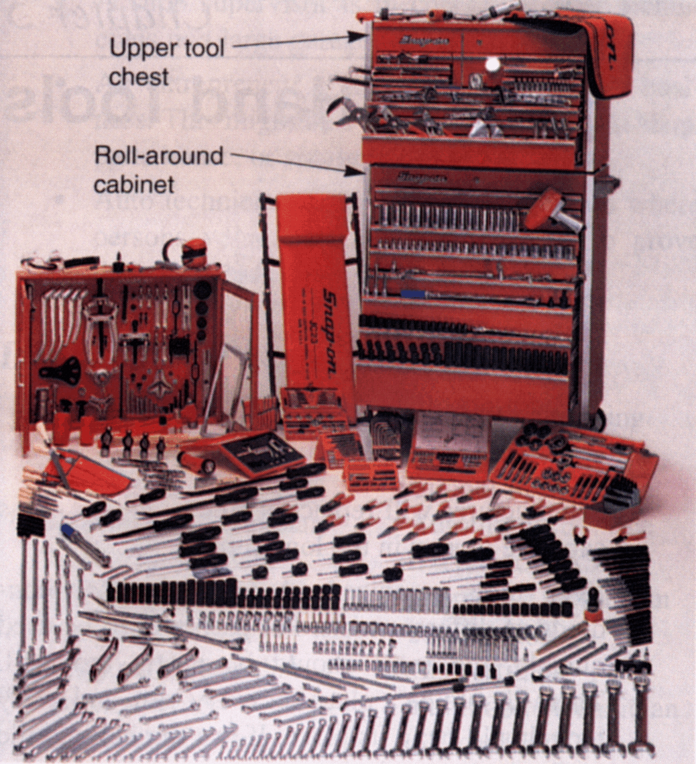

Slide 3
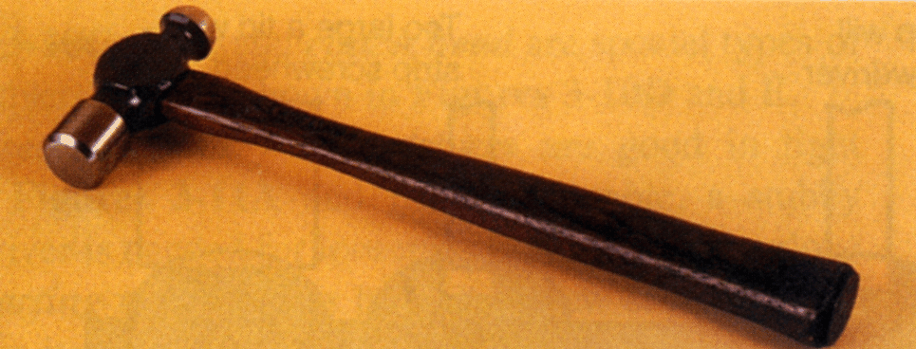
HAMMERS
Used for striking, riveting, and gasket cutting
Wear eye protection

Slide 4
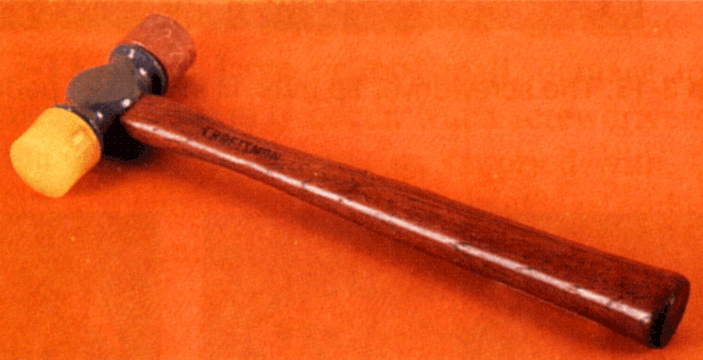
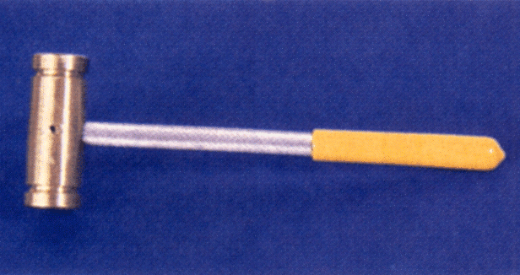
HAMMERS
Plastic, lead and rubber mallets are used to prevent damaging the surface

Slide 5
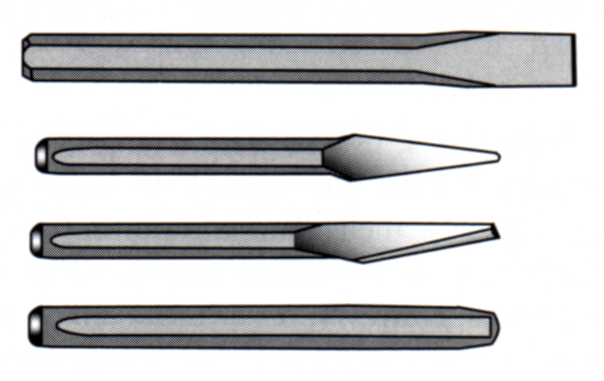
CHISELS
Used for cutting off rivet heads, bolts and rusted nuts

Slide 6
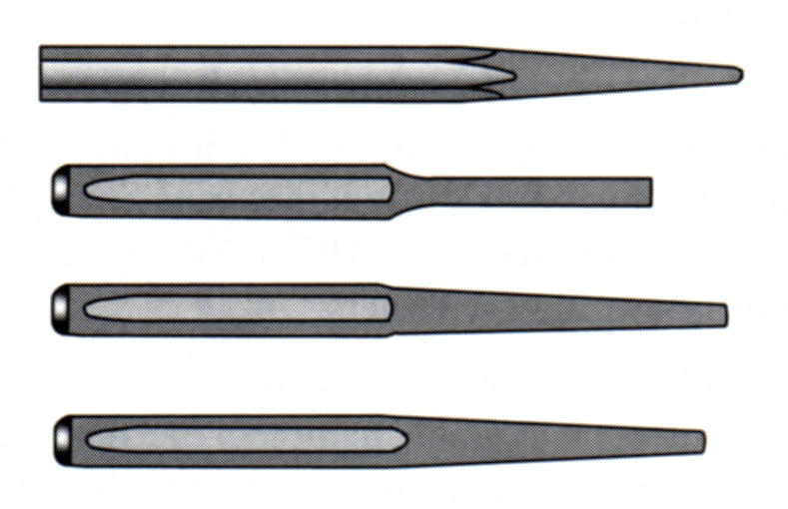
PUNCHES
Center Punch
Preps for drills
Pin Punch
Removes pins
Drift Punch
Aligns holes
Taper Punch
For hitting

Slide 7
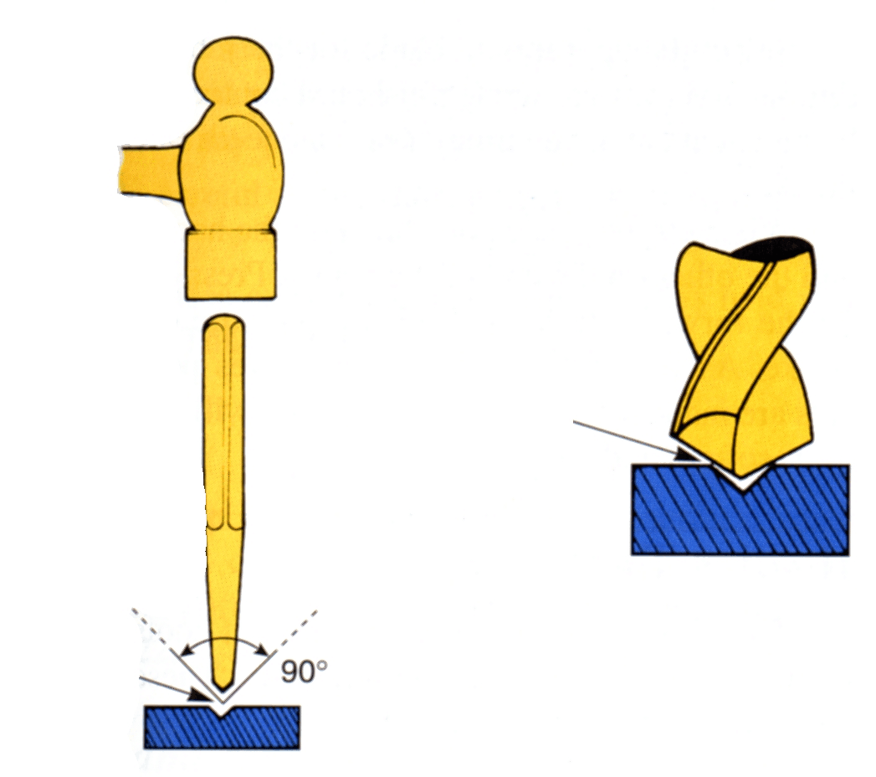
PUNCHES
A Center Punch is needed to mark material before drilling

Slide 8
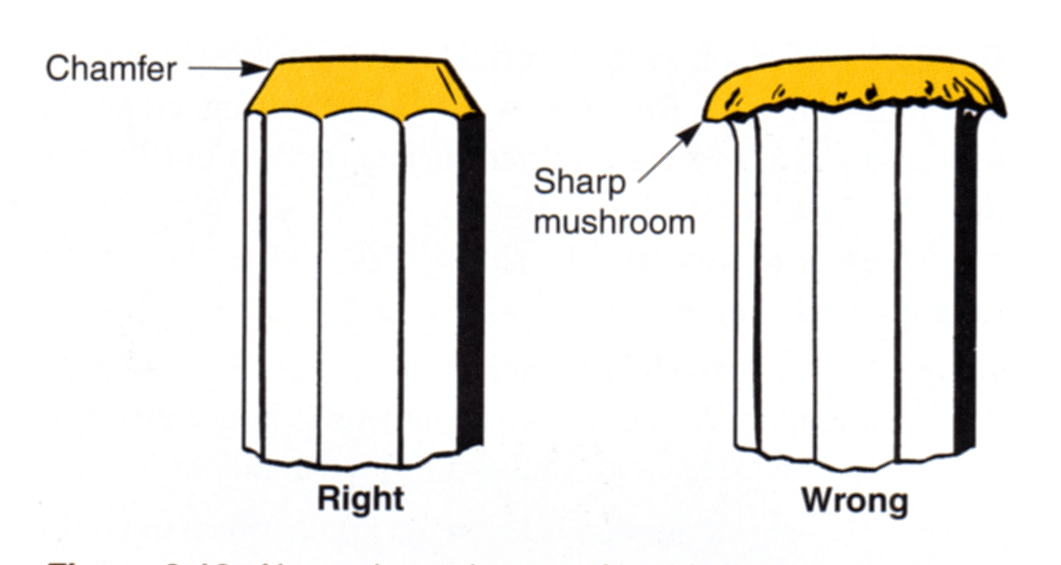
PUNCHES
Aside from sharpening, the ends need to be chamfered as they are used

Slide 9
FILES
Used to shape and smooth material
Single (smooth) or Double cut (rough)
Always use a handle

Slide 10
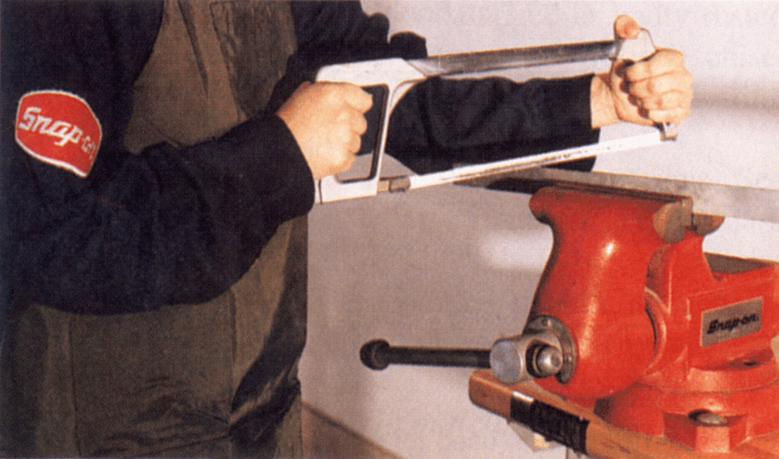
HACKSAWS
Used to cut tubing, bolts, other materials
Let the saw do the work

Slide 11
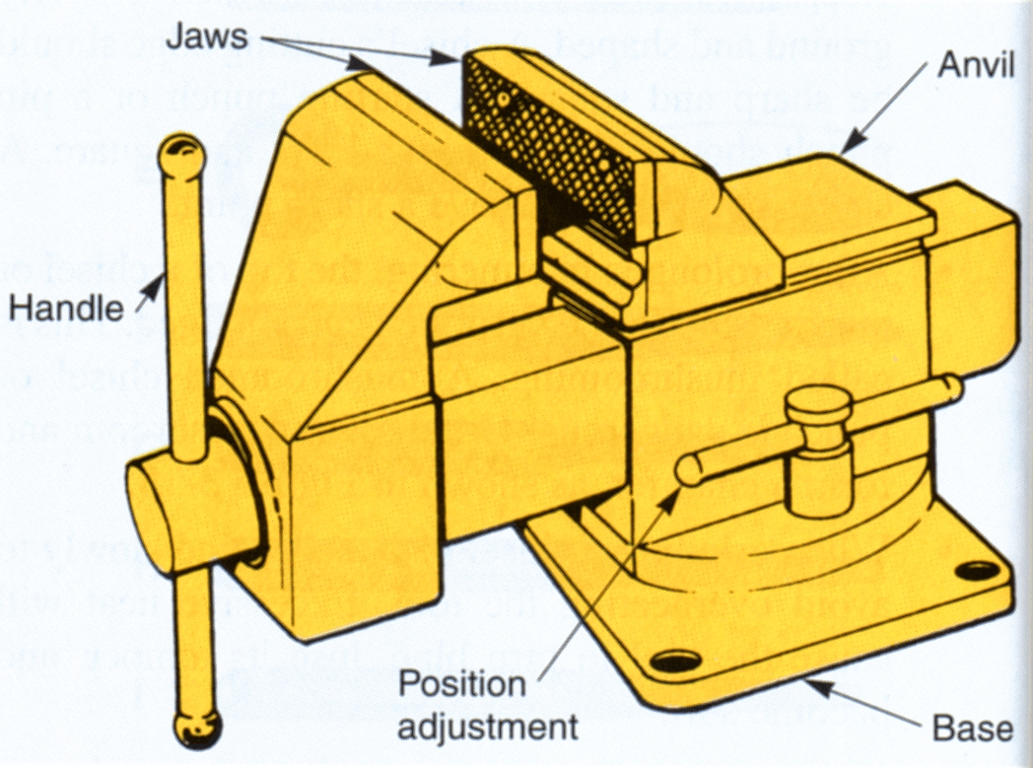
VISE
A bench mounted clamp

Slide 12
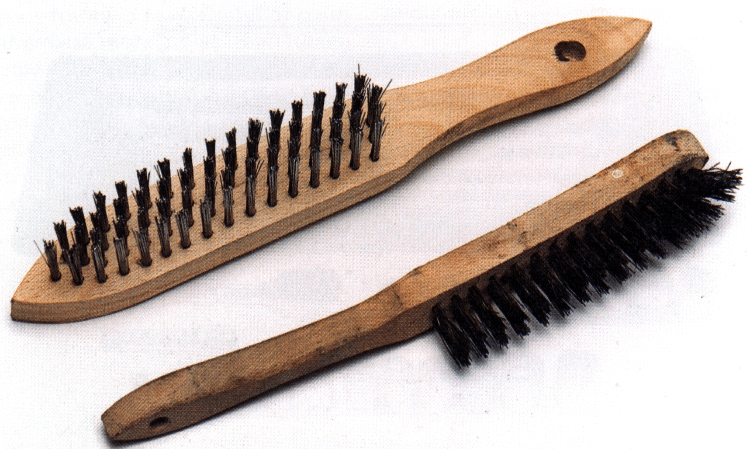
CLEANING TOOLS
Wire Brushes and Gasket Scrapers
Wear eye protection!

Slide 13
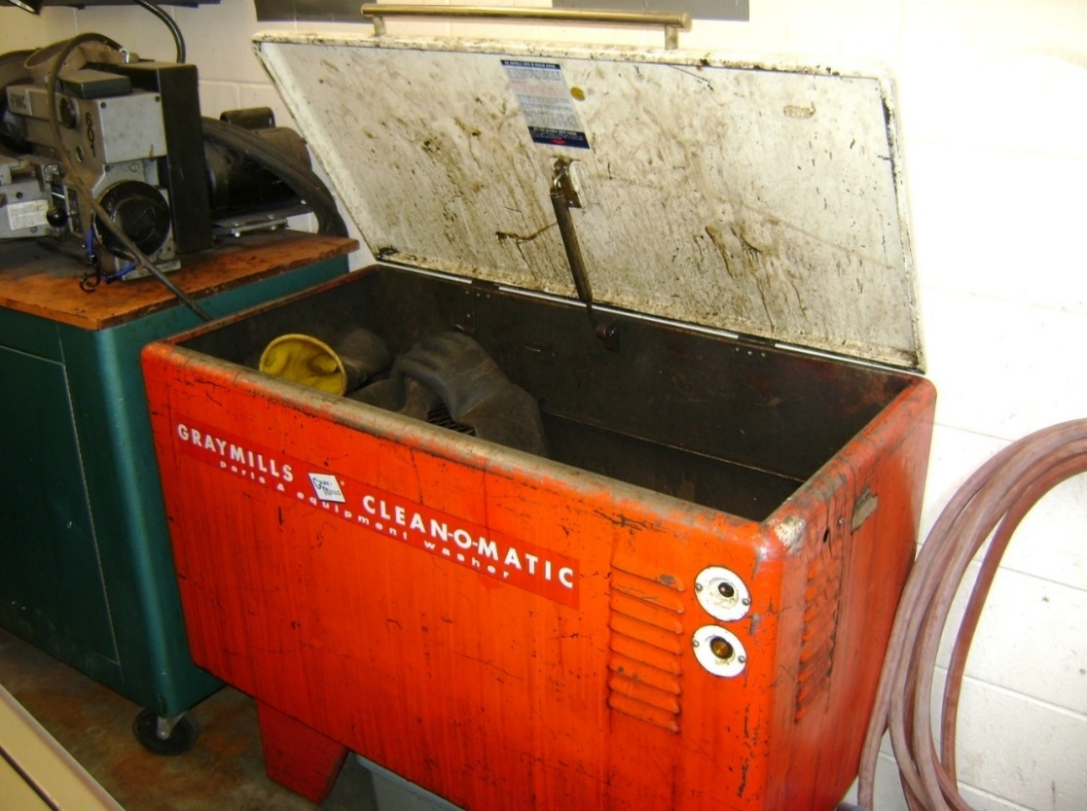
CLEANING TOOLS
Solvent Tank
Wear eye protection!
Wear rubber gloves!

Slide 15
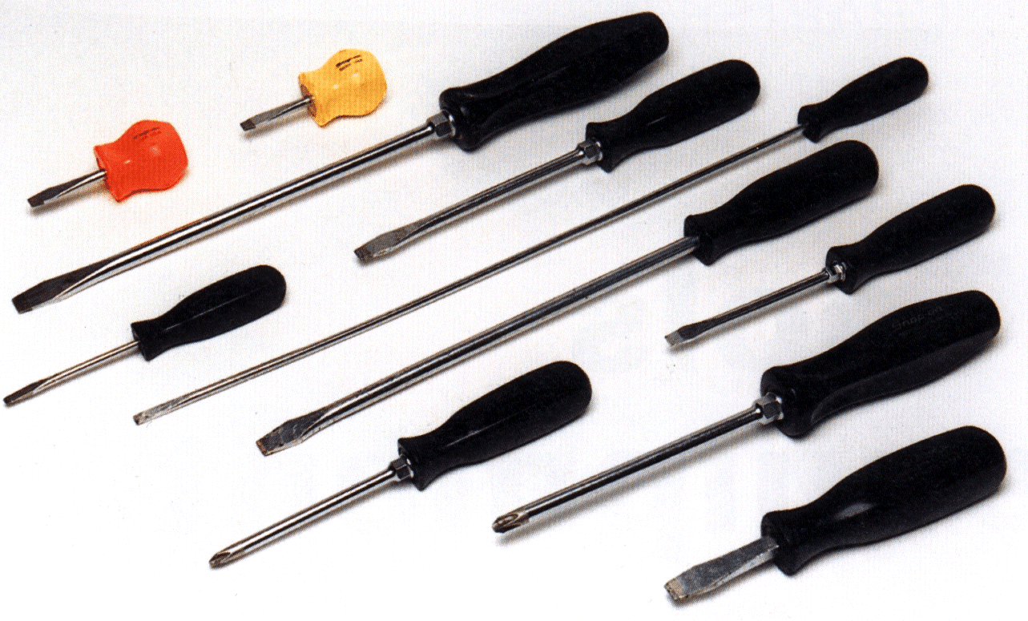
SCREWDRIVERS
Flat blade
Philips
Robertson
Torx
Clutch
Do not use as a pry bar
Instead, use a pry bar

Slide 16
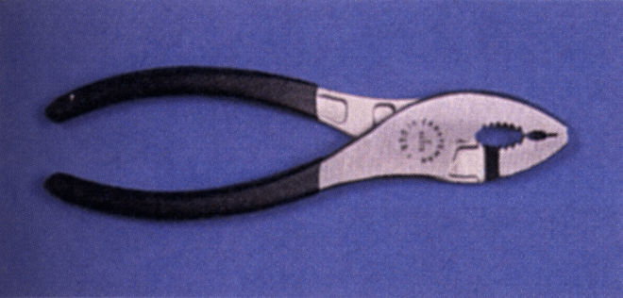
SLIP JOINT PLIERS
Two sizes of adjustability

Slide 17
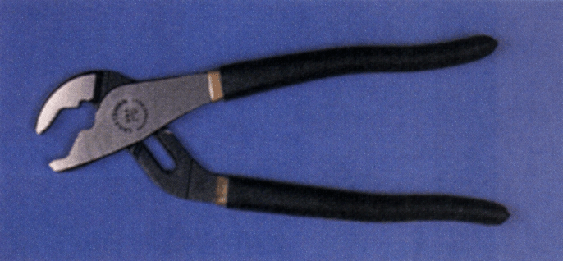
WATER PUMP PLIERS
Five or so sizes of adjustability
“Channel-Lock” is a brand name

Slide 18
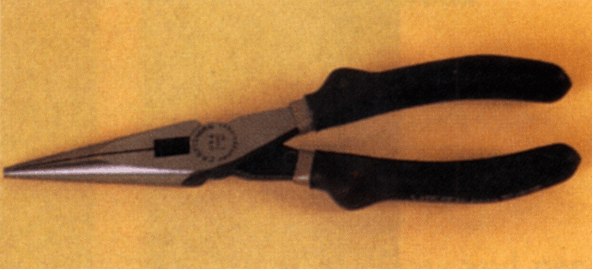
NEEDLE NOSE PLIERS
Great for grabbing or holding small clips or pins
Also has a small wire cutter

Slide 19
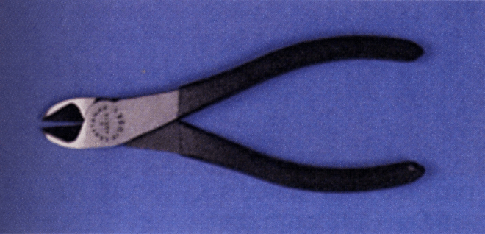
SIDE CUTTERS
Also called Diagonal Pliers
For cutting ROUND

Slide 20
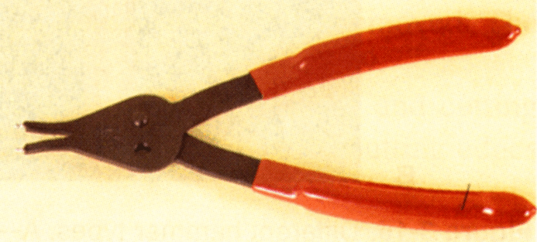
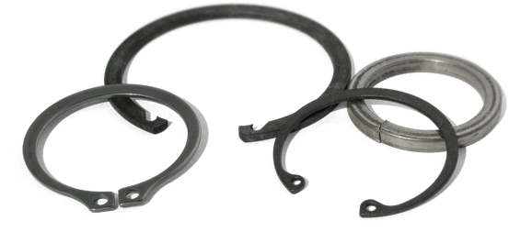
SNAP RING PLIERS
Internal or External

Slide 21
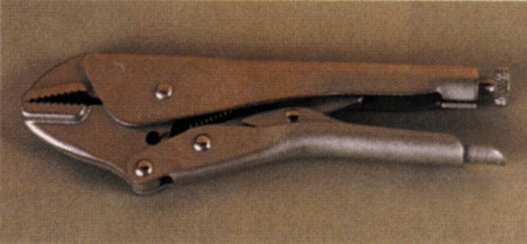
LOCKING PLIERS
“Vice Grip” is a brand name

Slide 22
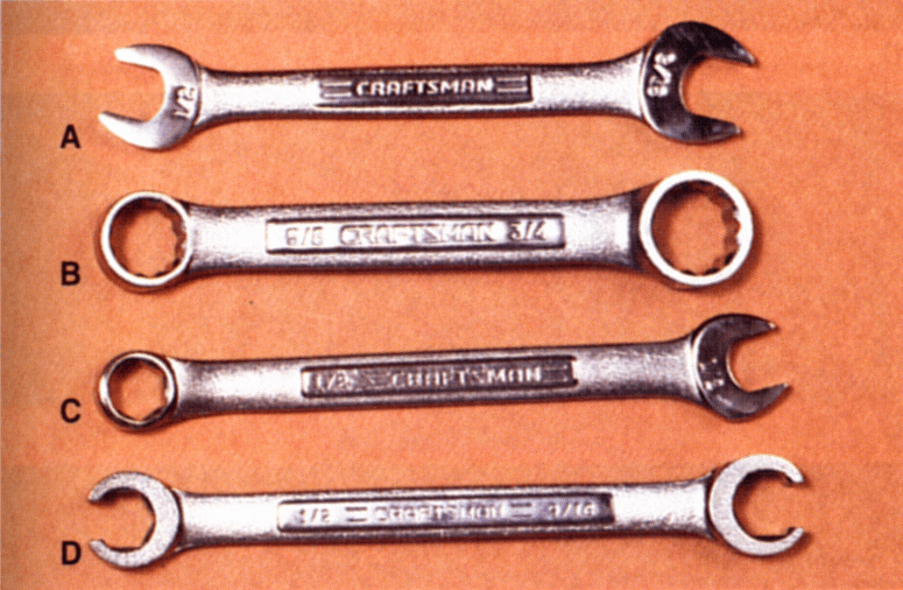
WRENCHES
Open End
Box End
Combination End
Flare Nut Wrench

Slide 23
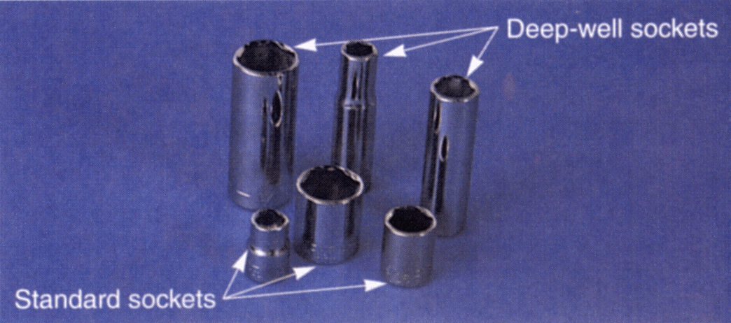
SOCKETS
Fastest and most convenient
6-point and 12-point
Deep-well and standard (shallow) depth

Slide 24
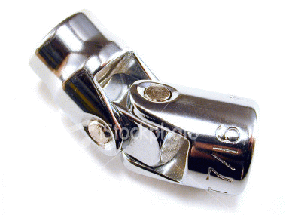
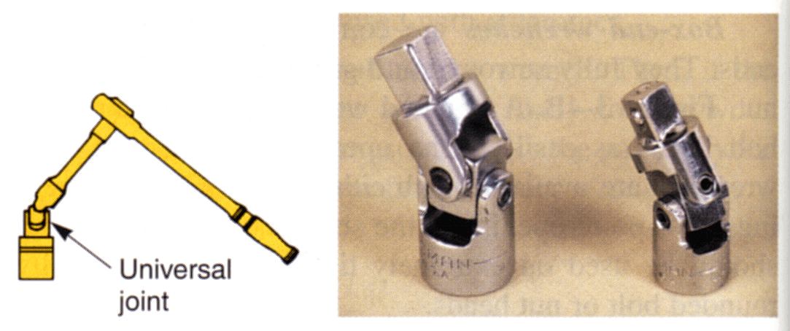
SWIVEL SOCKETS
Allows the user to turn fastener at an angle
Universal Joint has no socket

Slide 25
SPEED HANDLE
Allows faster removal/installation

Slide 26
BREAKER BAR
THIS IS THE TOOL YOU WANT
Also called a Flex-Bar
Allows considerable leverage

Slide 27
RATCHET HANDLE
Ratcheting mechanism inside allows rapid use in a confined space

Slide 28
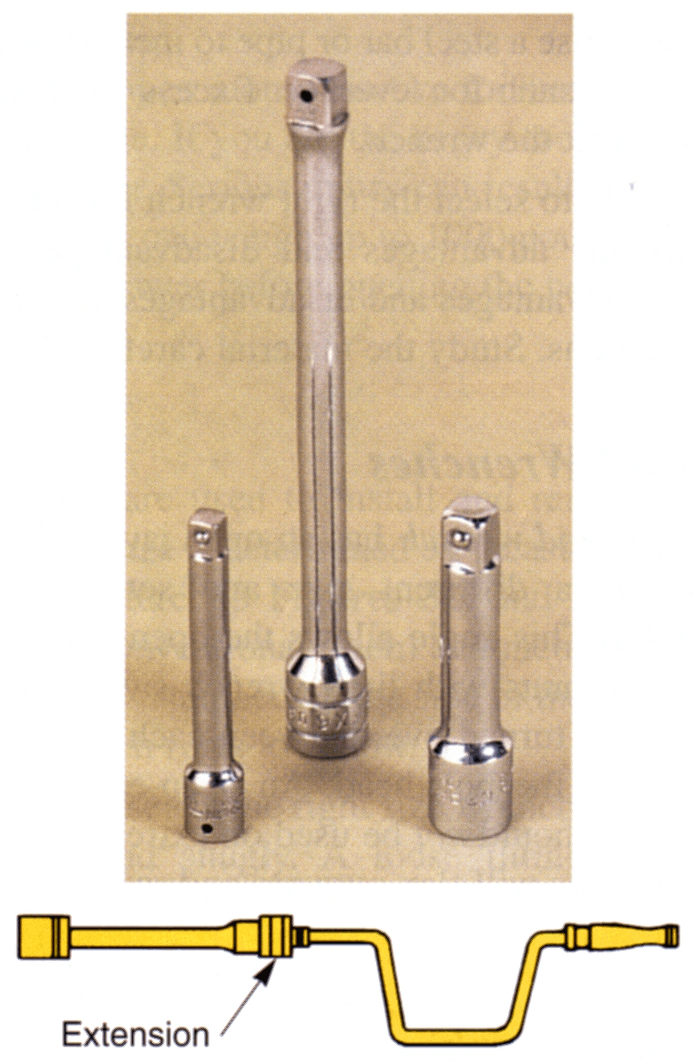
EXTENSIONS
Allows a longer reach
CAUTION: extensions “flex”, reducing force

Slide 29
REMOVING BROKEN BOLTS
Broken fasteners is a FACT OF LIFE
Try to avoid breaking the fastener in the first place:
Turn the correct direction
Penetrating oil
Heat
Tapping with hammer
When a fastener breaks, there are ways of dealing with it. Try the easiest fixes first….

Slide 30
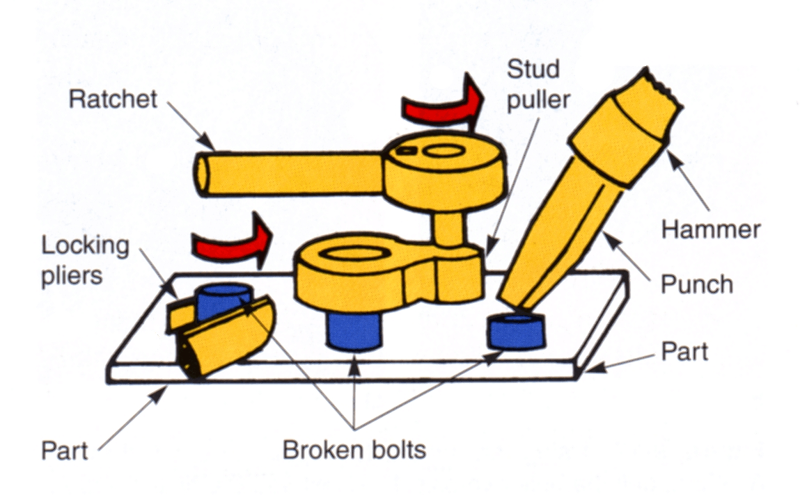
REMOVING BROKEN BOLTS

Slide 31
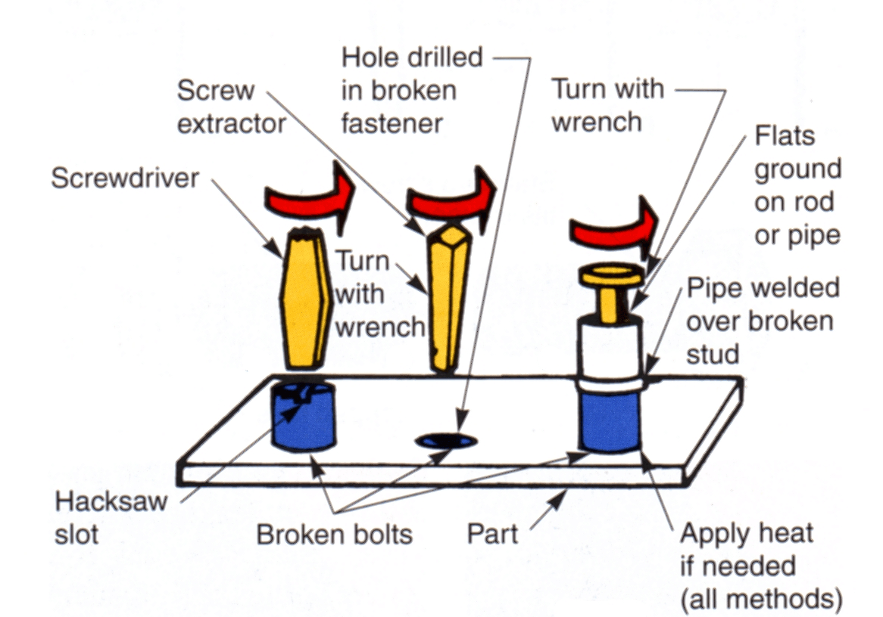
REMOVING BROKEN BOLTS

Slide 32
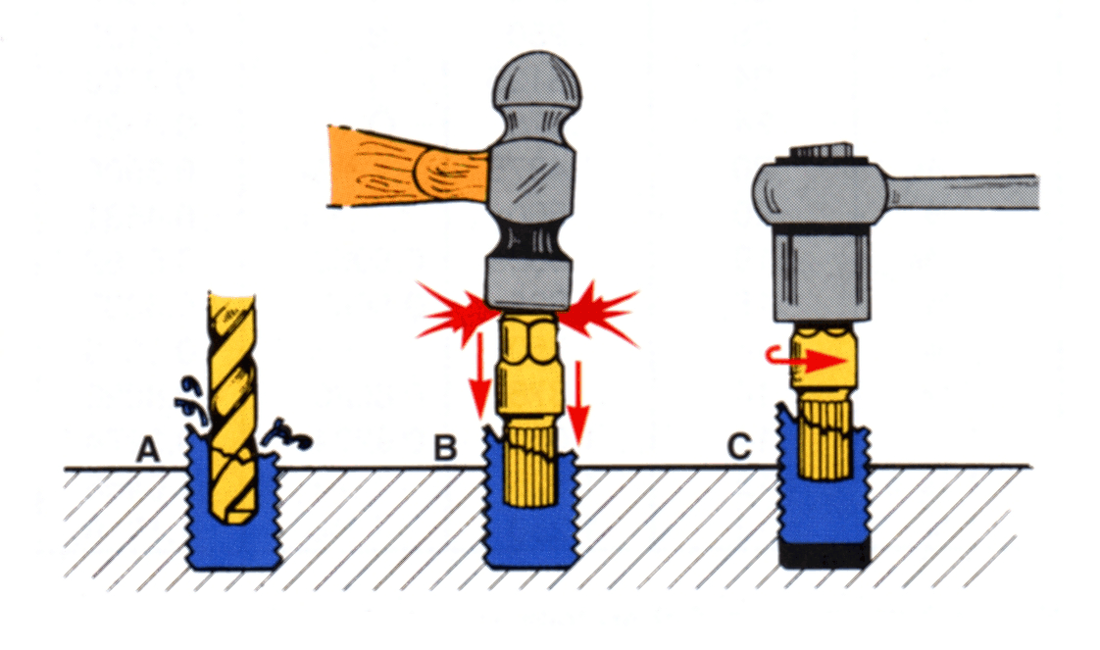
REMOVING BROKEN BOLTS

Slide 34
FIXING DAMAGED THREADS
Reality 1: When a threaded hole becomes stripped or damaged (usually aluminum threads)
Reality 2: When removing or drilling out a broken fastener goes horribly wrong
“Heli-Coil” to the rescue
(but they’re not cheap)

Slide 35
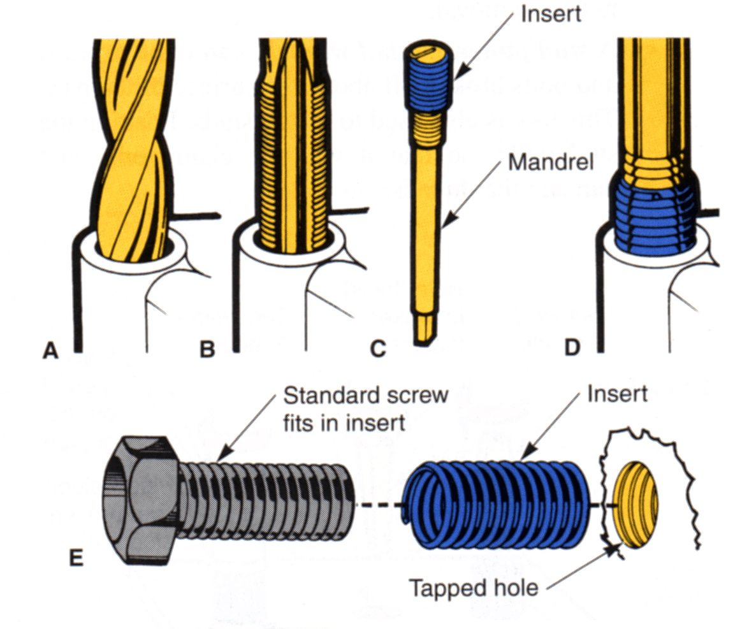
FIXING DAMAGED THREADS

Slide 36
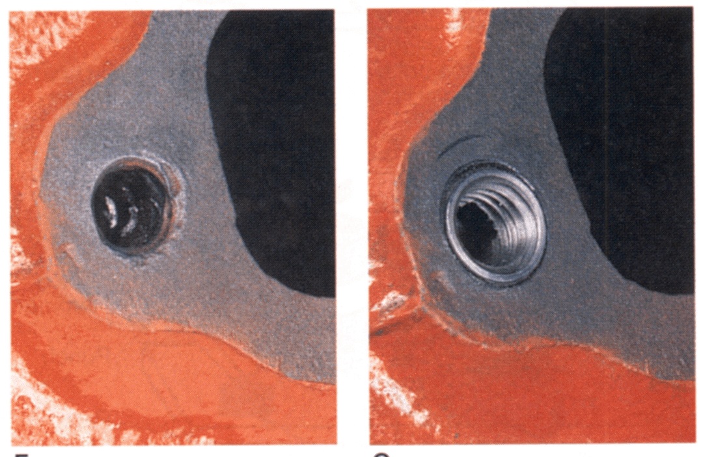
FIXING DAMAGED THREADS

Slide 38
ADJUSTABLE WRENCHES
DO NOT use these.
DO NOT use these.

Slide 39
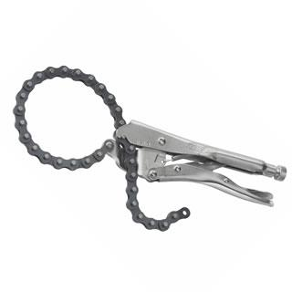
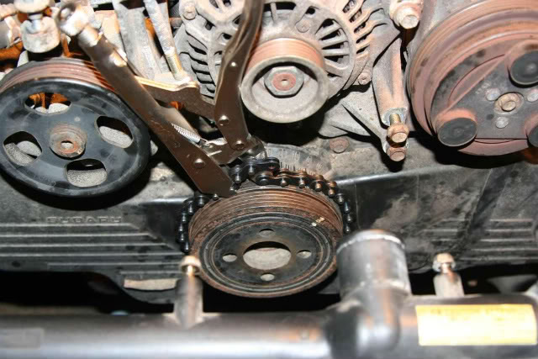
CHAIN WRENCH
Greatest tool ever made

Slide 40
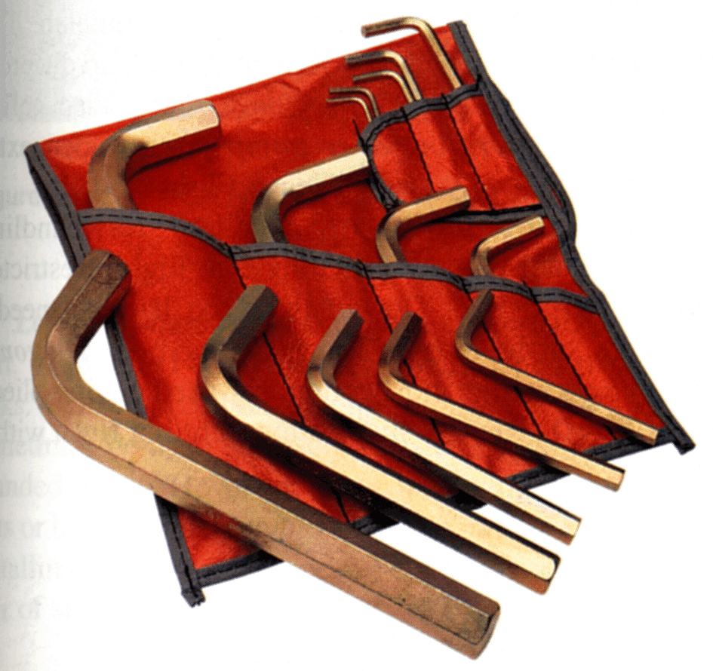
ALLEN WRENCHES
Used for set screws and cap screws

Slide 41
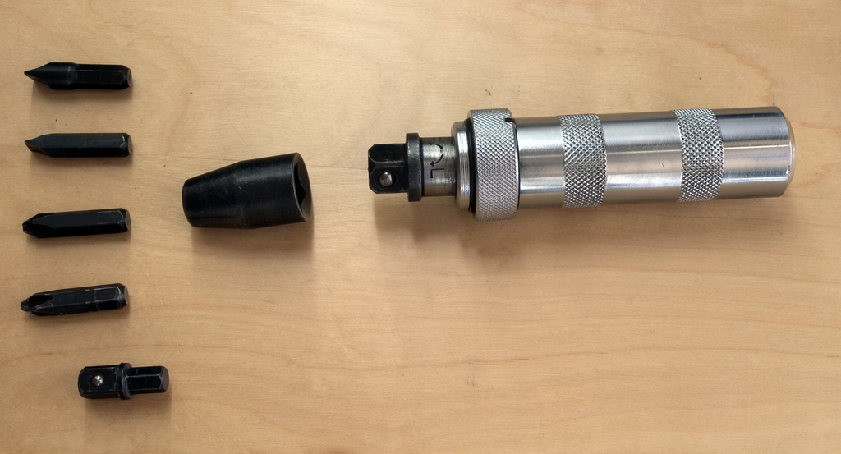
IMPACT DRIVER
Greatest tool ever made
Loosens the impossible (with a hammer)
Wear eye protection

Slide 43
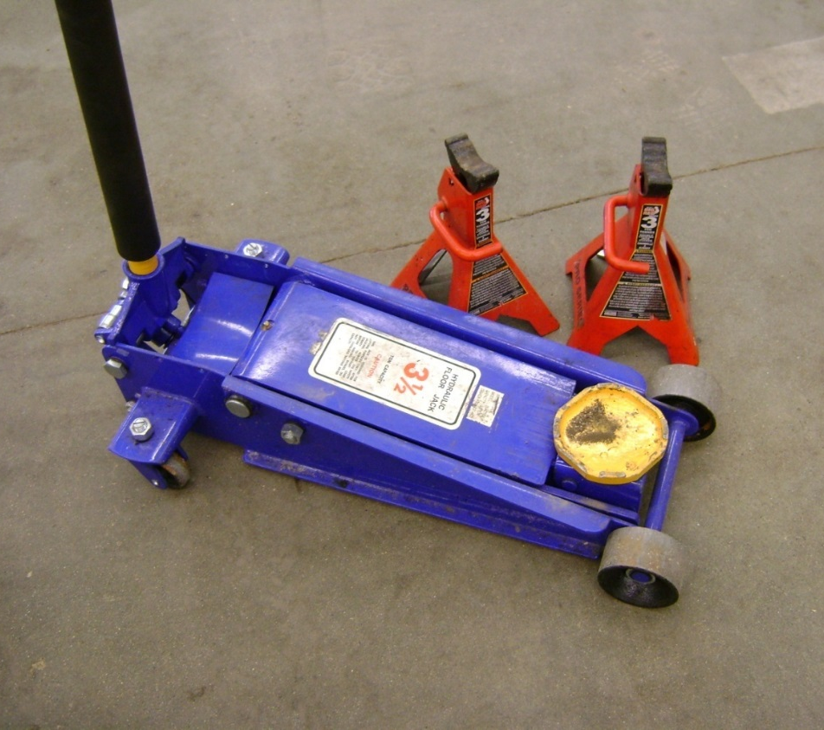
FLOOR JACK AND STANDS
SPECIFIC “jacking points”
ALWAYS use jack stands
ALWAYS raise jack handle

Slide 45
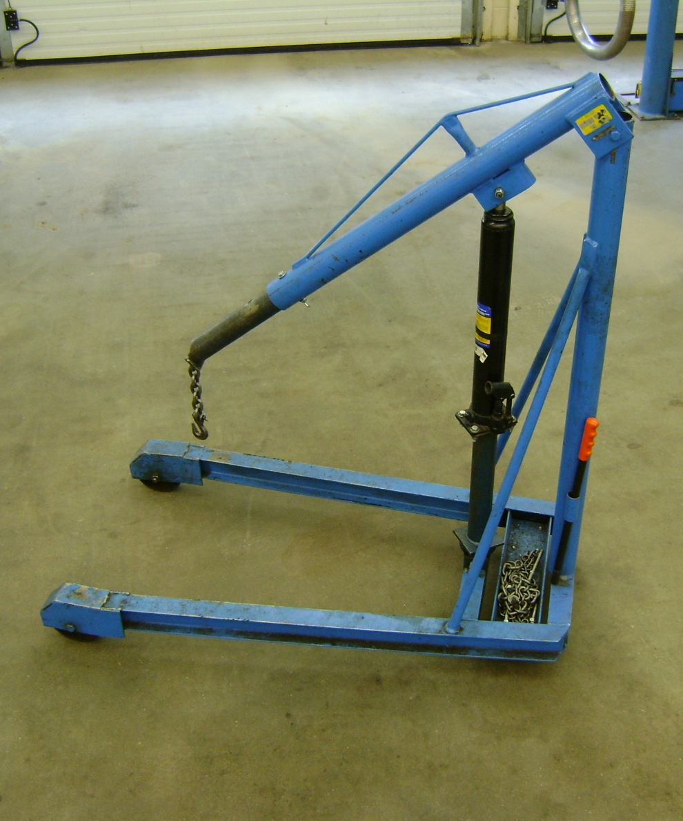
ENGINE CRANE
AKA “Cherry Picker”
Lifts engines out of vehicles
Chain must be WELL secured
NEVER go under an engine supported only by a chain

Slide 46
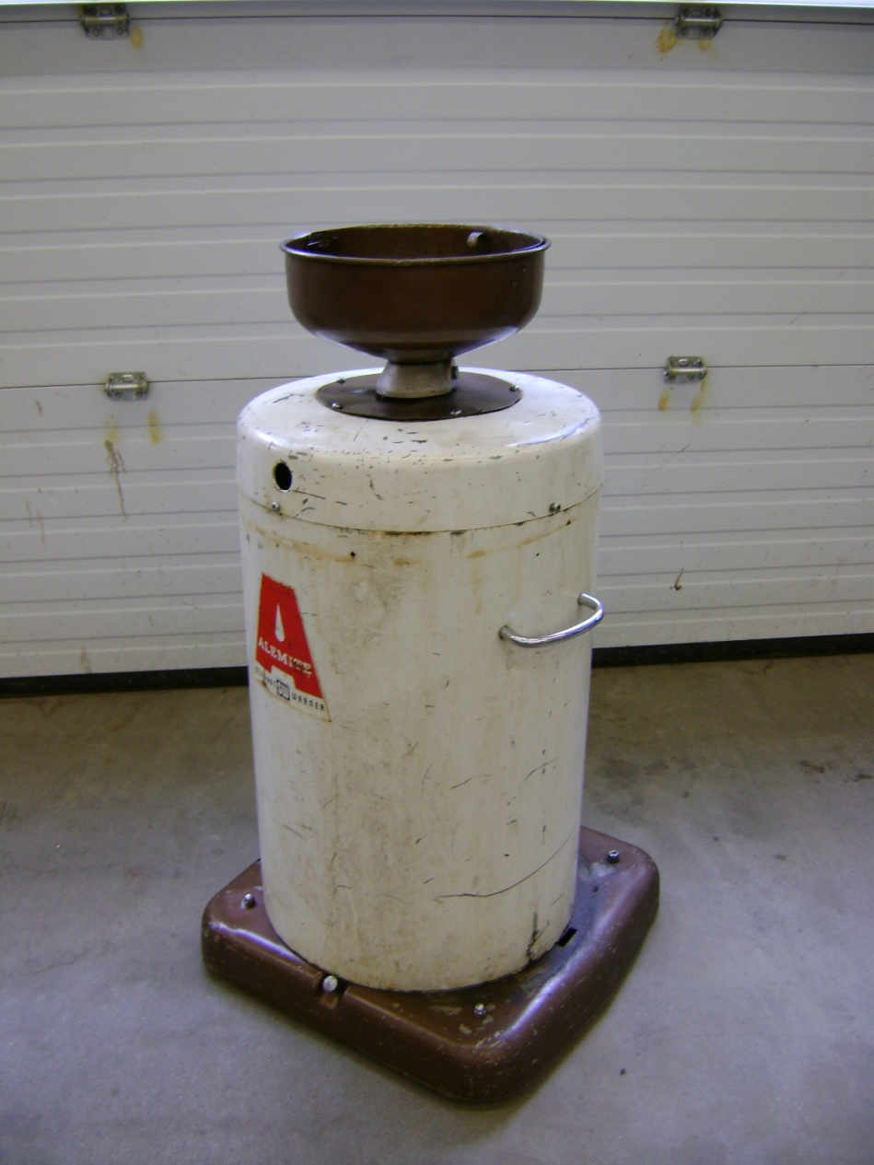
OIL DRAIN
Stores drained engine or transmission oil
Must be emptied frequently

Slide 47
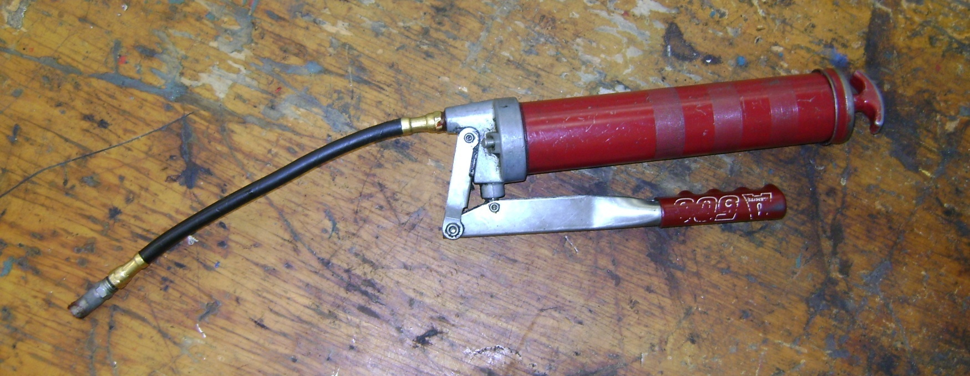
GREASE GUN
Used to lubricate steering and supension components through grease fittings

Slide 48
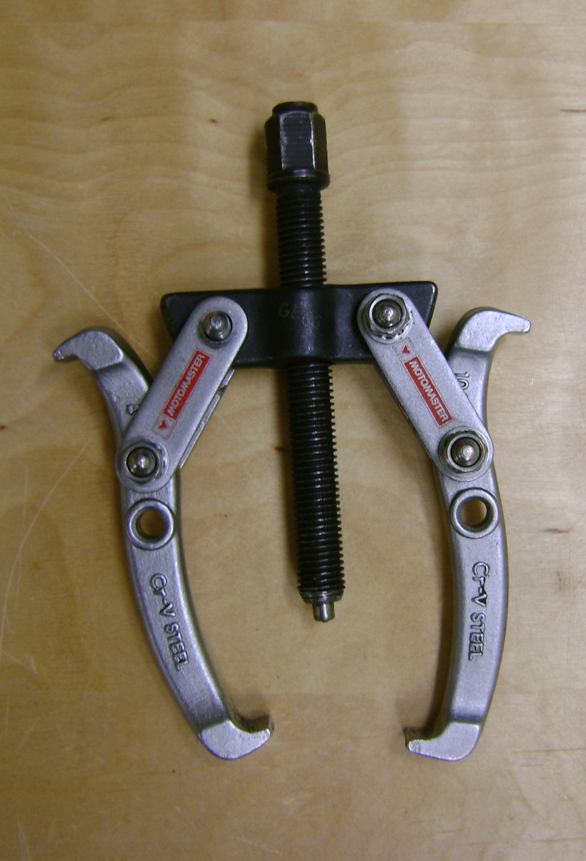
GEAR PULLER
Used to remove gears and pulleys
NOT for harmonic balancers

Slide 49
HARMONIC BALANCER PULLER

Slide 51
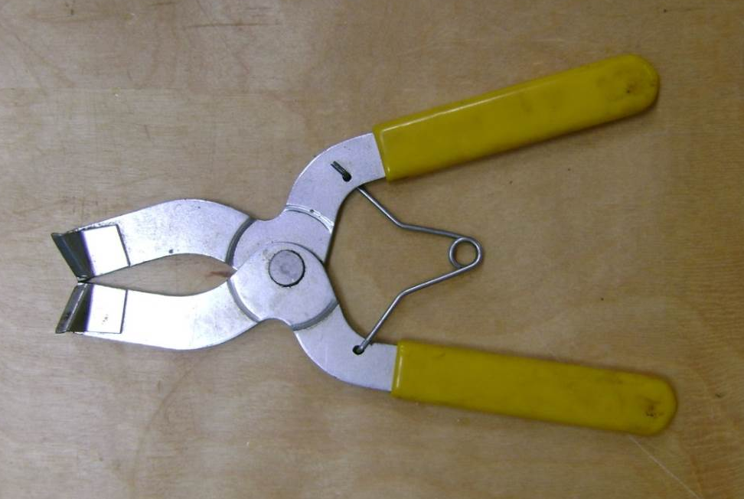
PISTON RING PLIERS
Used to remove/install piston rings from pistons without breaking them

Slide 53
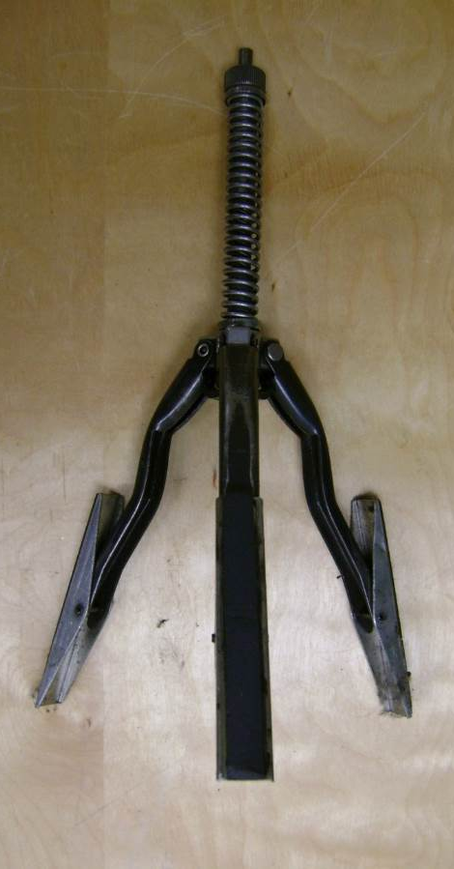
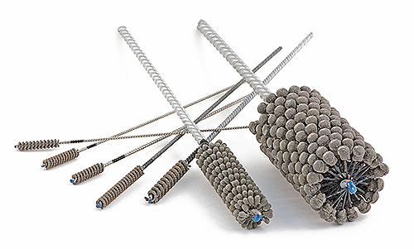
CYLINDER HONE
Used to remove glazing from cylinders in preparation for new rings
Used with a hand drill and honing oil
Flex Hone (top)
Ball Hone (bottom)

Slide 55
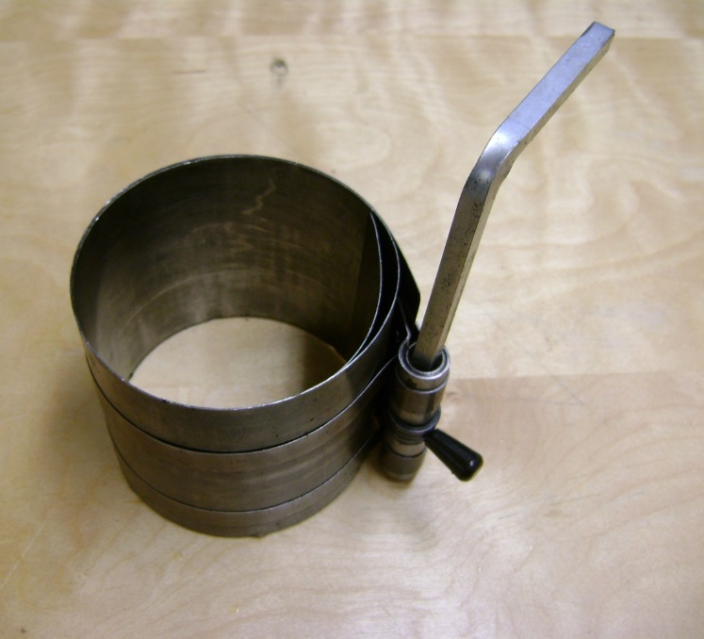
PISTON RING COMPRESSOR
Compressing piston rings into the ring grooves to fit pistons into the cylinders
Sharp edges may cut hands

Slide 57
TIRE INFLATOR
Used to inflate tires
Has a built-in pressure gauge

Slide 58
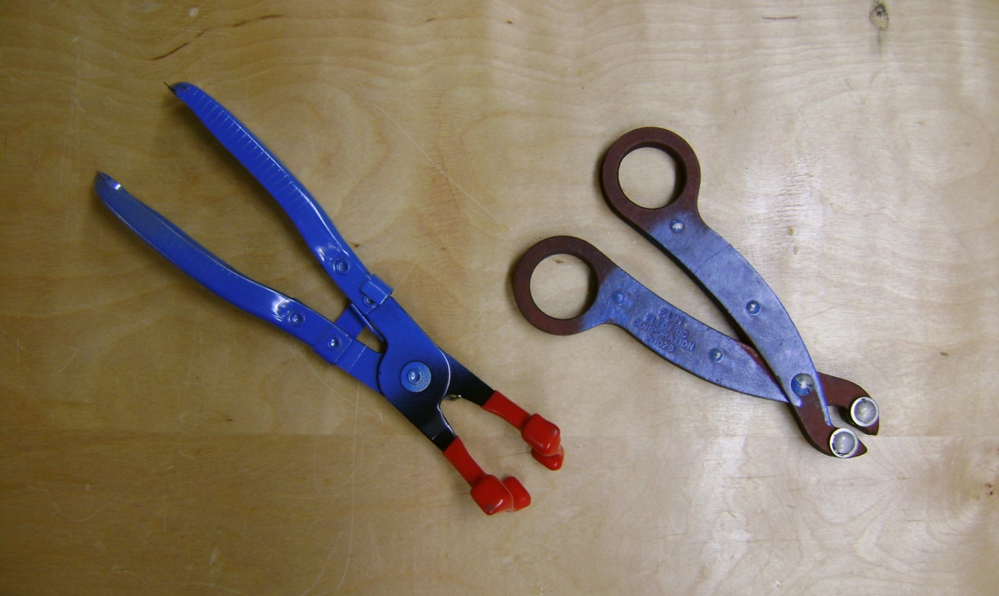
SPARK PLUG BOOT PLIERS
Removes stubborn and hard to reach spark plug boots

Slide 59
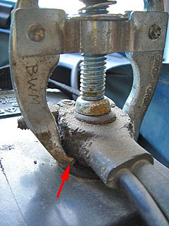
BATTERY CLAMP PULLER
Removes battery cable clamps without damage

Slide 60
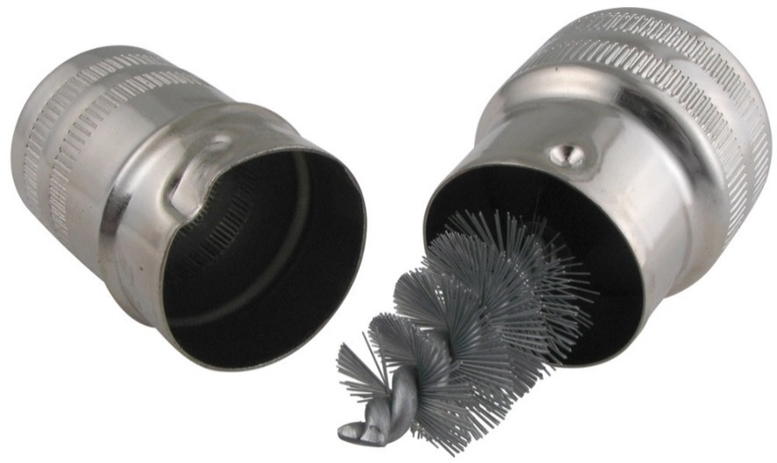
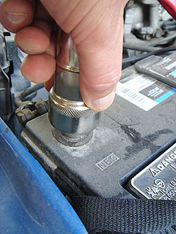
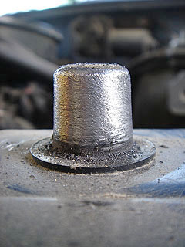
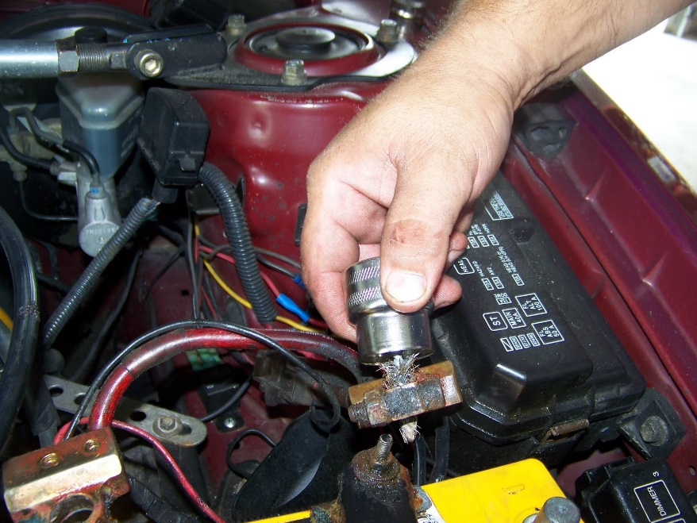
BATTERY POST CLEANER
Two wire brushes help to clean both battery posts and battery clamps

Slide 61
TORQUE WRENCH
A tool that allows a MEASURED amount of TIGHTNESS
NOT A BREAKER BAR!
NOT FOR “REMOVING” FASTENERS
This ruins the calibration

Slide 62
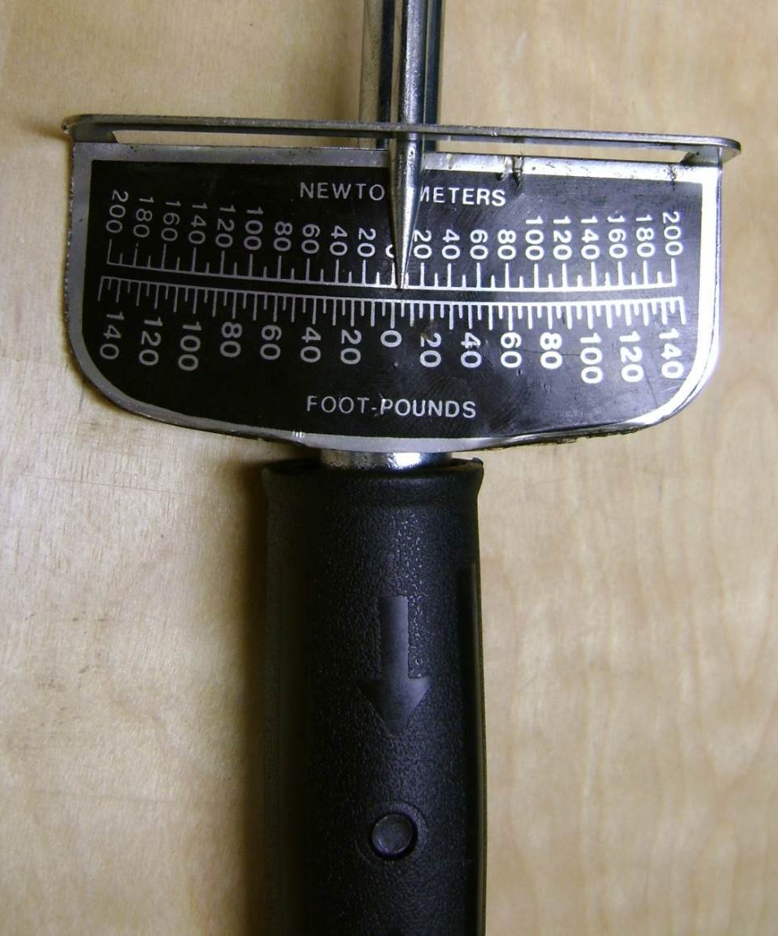
BEAM TORQUE WRENCH
Has a handle (that flexes) and a needle (that points to numbers)

Slide 63
MICROMETER TORQUE WRENCH
Dial up desired torque by turning the handle
Lock it
Hear/feel “click”

Slide 65
TEST LIGHT
“Idiot Light”
Tests electrical circuits
Handle lights up when voltage is present
DO NOT use with computer-controlled components

Slide 66
DO NOT use this to test computer components

Slide 67
VALVE SPRING COMPRESSOR
Used for disassembling Cylinder Heads
This type requires cylinder head removal

Slide 69
Screw head shapes?
Push or pull the wrench?

