Slide 1
METAL SHOP SAFETY
IF YOU CAN’T BE SAFE, YOU CAN’T BE HERE

Slide 2
BEHAVIOUR
NO HORSEPLAY
NO ROUGH-HOUSING
NO RUNNING
8

Slide 3
BEHAVIOUR
NO UNNECESSARY NOISE
We need to hear what’s going on
Machines: “good” sounds and “bad” sounds
PAY ATTENTION TO OTHERS
They might not pay attention to you
8

Slide 4
ATTIRE
NO JEWELRY
Rings, bracelets, necklaces,
ties, etc.
NO LOOSE CLOTHING
Hoodie strings, baggy clothes, earphones, etc
8

Slide 5
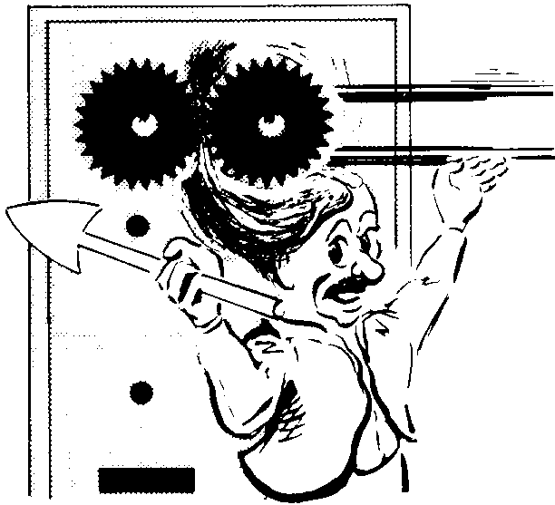
ATTIRE
NO LONG HAIR
Tie it back
WEAR NATURAL FIBER
CLOTHING
Cotton, leather, etc.
8

Slide 6
PROCEDURAL
WORK CLEAN & HELP CLEAN
A clean shop is a safe shop
NO DISTRACTIONS
iPod, daydreaming, under influence of…?
8

Slide 7
PROCEDURAL
ASK FOR HELP or DEMOS
I love the “teaching” part of my job
LOCKOUT or UNPLUG the machine when making adjustments
No accidental “turn on”
8

Slide 8
PROCEDURAL
STAND AN ARM’S LENGTH AWAY
If the operator could punch you, you’re too close, give them room
KEEP FINGERS A HAND WIDTH’S AWAY FROM CUTTERS
“No Finger Zone”
8

Slide 9
SAFETY EQUIPMENT
THE #1 MOST IMPORTANT:
EYE PROTECTION
Cutting, striking, shaping or
removing metal
8

Slide 10
SAFETY EQUIPMENT
HAND PROTECTION
Risk of burns or cuts
Don’t get them wet! (wrecks them)
Don’t pick up hot metal! (wrecks them)
EAR PROTECTION
Near loud noises
If you have to raise your voice,
you need ear protection
8

Slide 11
TOOLS

Slide 12
AVIATION SNIPS
For cutting SHEET METAL only! (it shears)
Serrated teeth
Green Cuts Left
Yellow Cuts Straight
Red Cuts Right
8

Slide 13
SIDE CUTTERS
AKA “Diagonal Pliers”
For cutting ROUND material (it pinches)

Slide 14
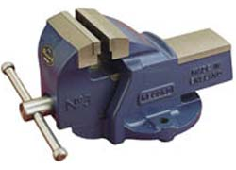
VISE
For CLAMPING your project
JAWS will damage your project
Use SOFT metal to protect YOUR project
8

Slide 15
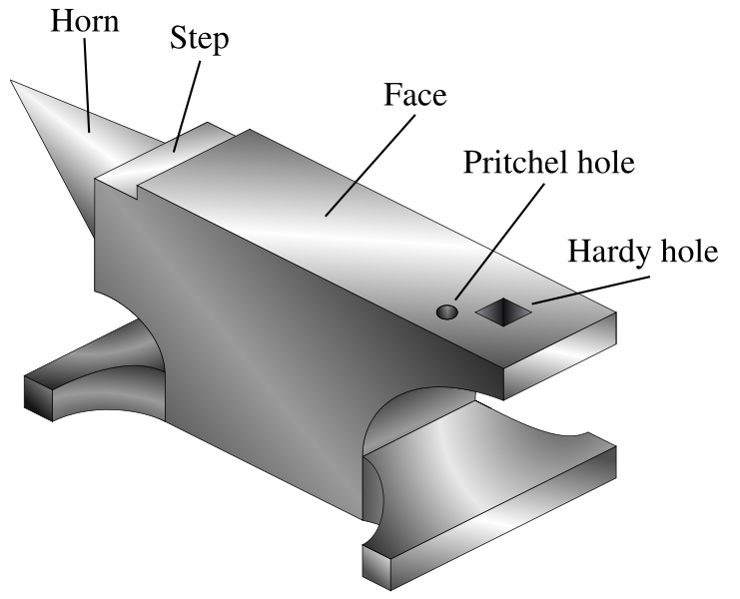
ANVIL
For SUPPORTING or SHAPING metal
Best for Center-Punching

Slide 16
BALL PEEN HAMMER
For SHAPING and STRIKING
WEAR EYE PROTECTION
Hardened steel (DO NOT STRIKE TWO HAMMERS TOGETHER)
8

Slide 17
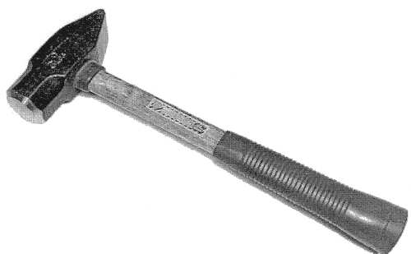
CROSS PEEN HAMMER
WEAR EYE PROTECTION
Pointy end used to widen metal in Blacksmithing

Slide 18
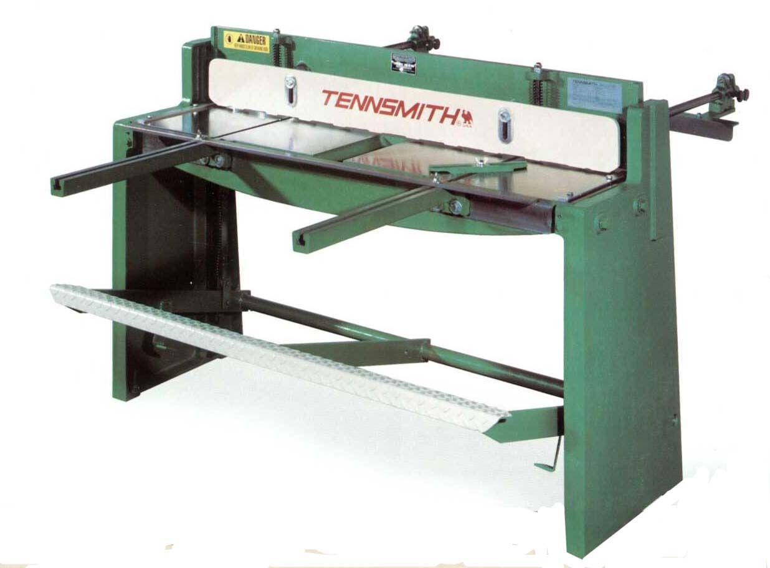
FOOT SHEAR
For cutting SHEET METAL ONLY
NO ROUND!!!
8

Slide 19
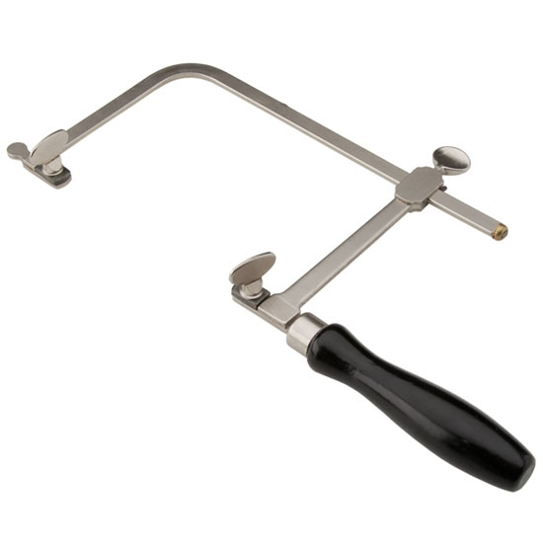
JEWELRY SAW
BABY the blade
Be VERY gentle!
Teeth point TOWARD the handle

Slide 21
FILE
For SHAPING metal
EASILY dulled, chipped or broken!
Be GENTLE!!!
DO NOT bang together or against anything
Works on PUSH stroke only
8

Slide 22
HAND DRILL & DRILL PRESS
Makes holes
Wear EYE PROTECTION
All material must be CLAMPED DOWN
8

Slide 23
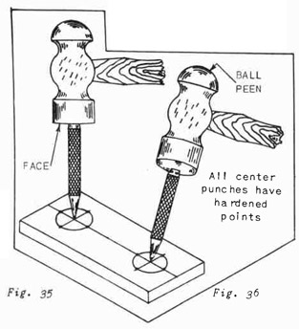
HAND DRILL & DRILL PRESS
All holes must be CENTER-PUNCHED
Any hole bigger than 1/4” must be PRE-DRILLED With a smaller drill bit
8

Slide 24
BUFFING WHEEL
For ART METAL CLASS only
Wear EYE PROTECTION
Polish on BOTTOM of wheel
(Top spins towards you)
CAUTION: Polishing gets HOT!
NO CHAINS!
8

Slide 25
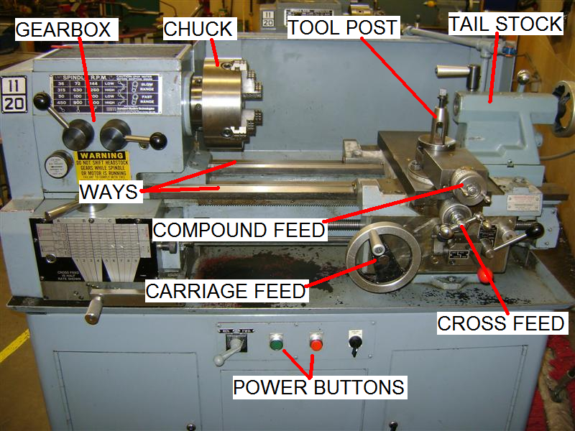
LATHE
8

Slide 26
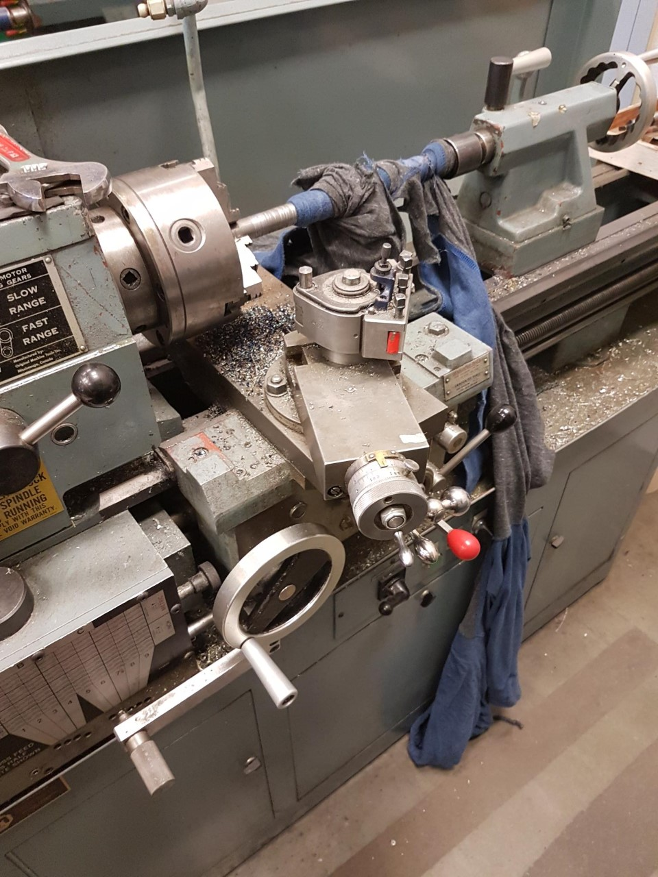
LATHE
Makes things ROUND
Wear EYE PROTECTION
Keep hands, arms, sleeves, hoodie strings THE HELL AWAY from the spinning chuck
It WILL mess you up
8
Notes:
Kid in Vernon. Lathe RIPPED his shirt off his body, and was pulling him in by the collar. His face was AT his work in SECONDS by the time the teacher got the power shut off.

Slide 27
8

Slide 28
LATHE
Be nice to the cutter – take BABY cuts
NEVER leave the CHUCK KEY in the CHUCK
Spin the chuck BY HAND before you turn it on
8

Slide 29
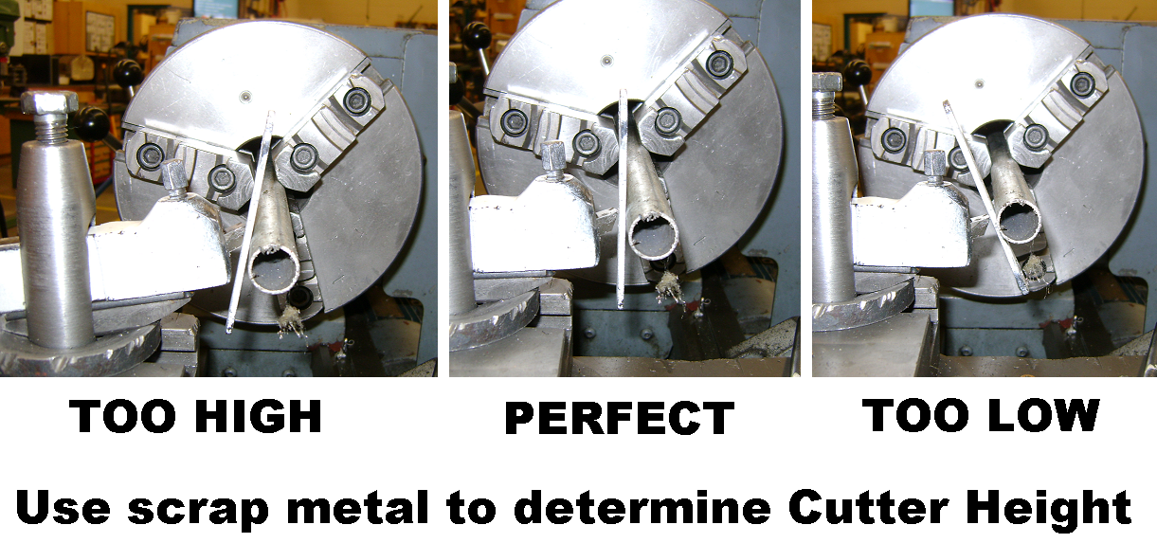
LATHE
Cutter should be ~90° to direction of travel
Cutting tip should be same height as project center
8

Slide 30
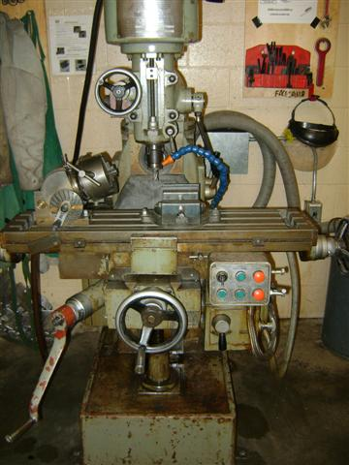
MILLING MACHINE
Makes things FLAT
Wear EYE PROTECTION
8

Slide 31
MILLING MACHINE
Material MUST be WELL CLAMPED
Keep hands, arms, sleeves, hoodie strings THE HELL AWAY from the spinning cutter
It WILL mess you up
8

Slide 32
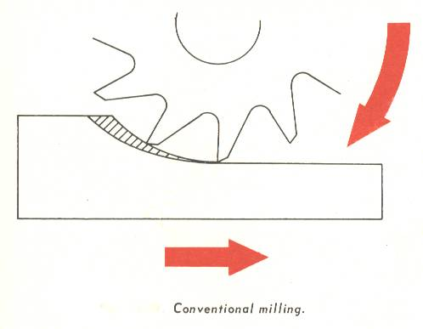
MILLING MACHINE
Cut AGAINST the rotation of the cutter
Be nice to the cutter – take light cuts (Chip Colour!)
8

Slide 33
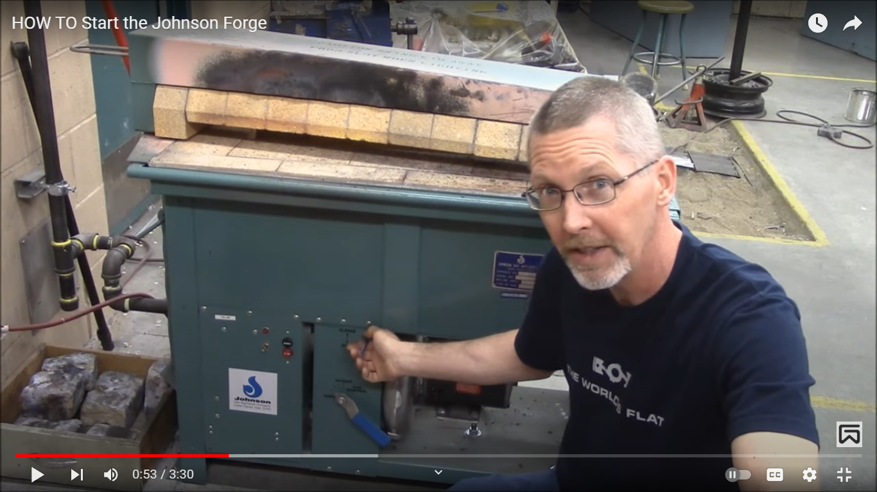
BLACKSMITH FORGE
HOT!
FACE SHIELD!
EAR PROTECTION!
LEATHER GLOVES!
LEATHER JACKET
BRAINS
There’s a story behind that….

